Slide 1
Tableau
Data Blending

Slide 2
Data Blending
The key steps to data blending:
Data Acquisition: Identify and obtain access to the data within your sources
Joining Data : Combine the edited data for further use and analysis
Data Cleansing: Redesign the data into a usable/functional format and correct/remove any bad data

Slide 3
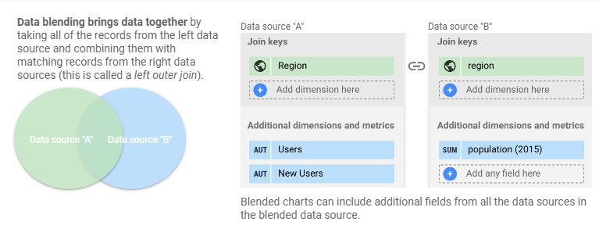
Data Blending

Slide 4
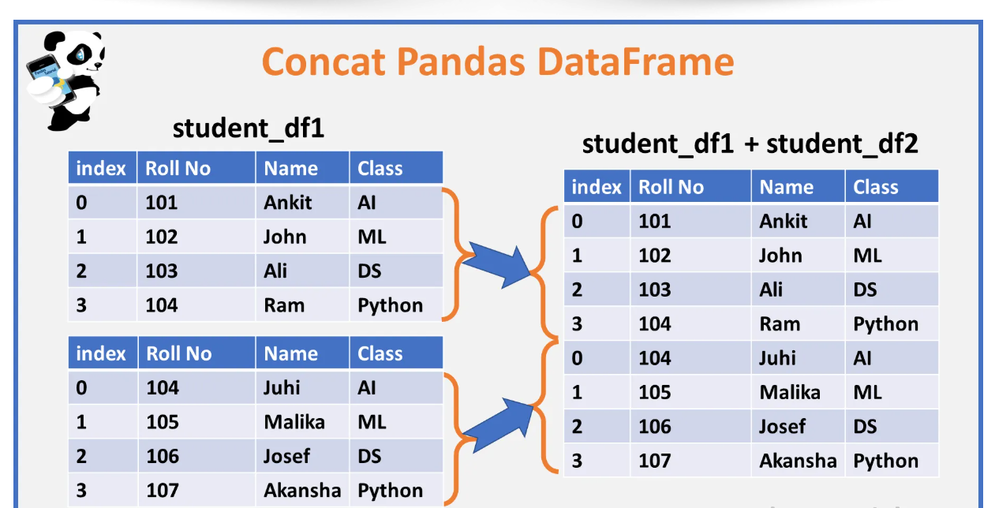
CONACT

Slide 5
APPEND
SAME

Slide 6
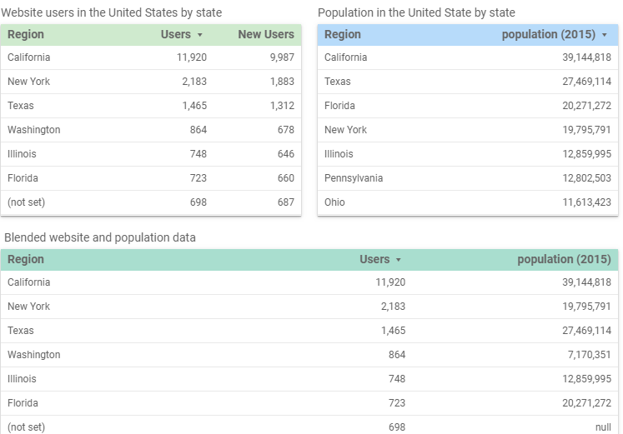
Data Blending Result

Slide 7
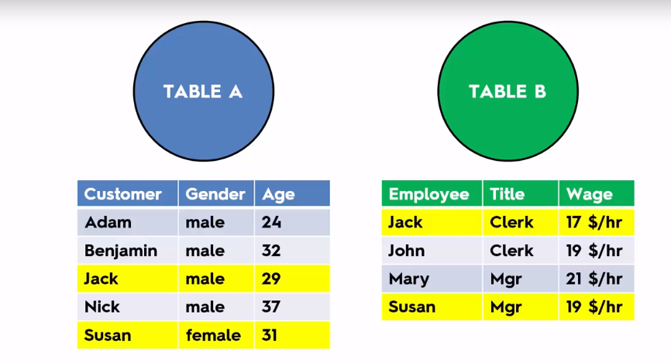
Steps for Join

Slide 8
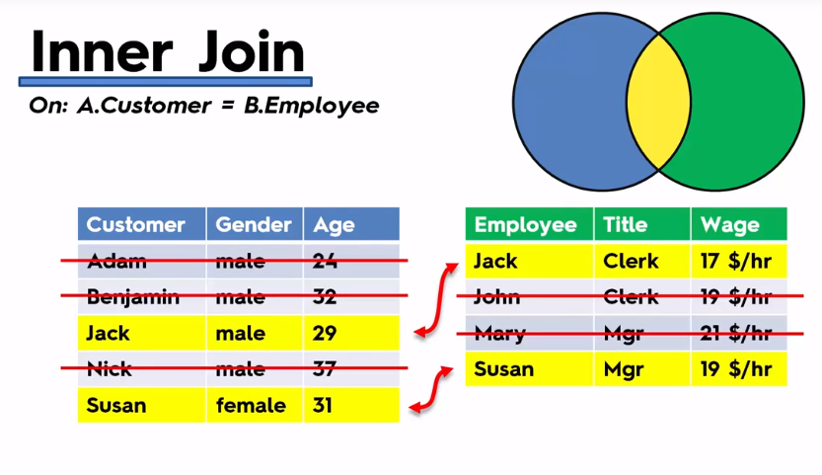
Inner Joint

Slide 9
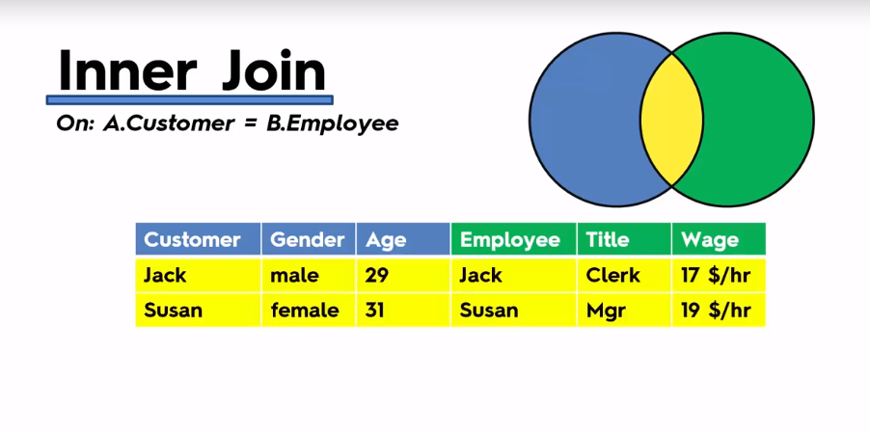


Result of Inner Join

Slide 10
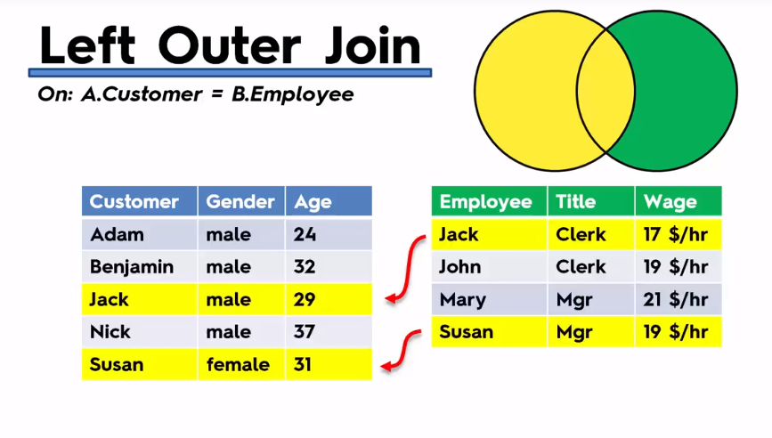
Left Outer Joint

Slide 11
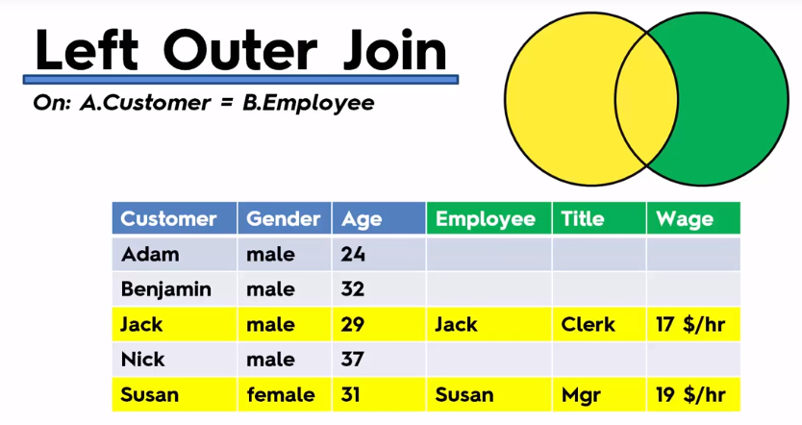
Left Joint Result

Slide 12
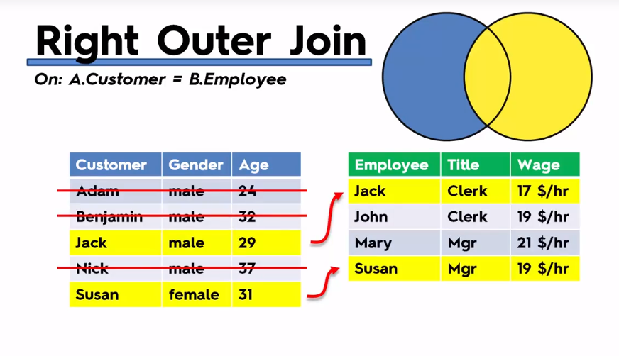
Right Join

Slide 13
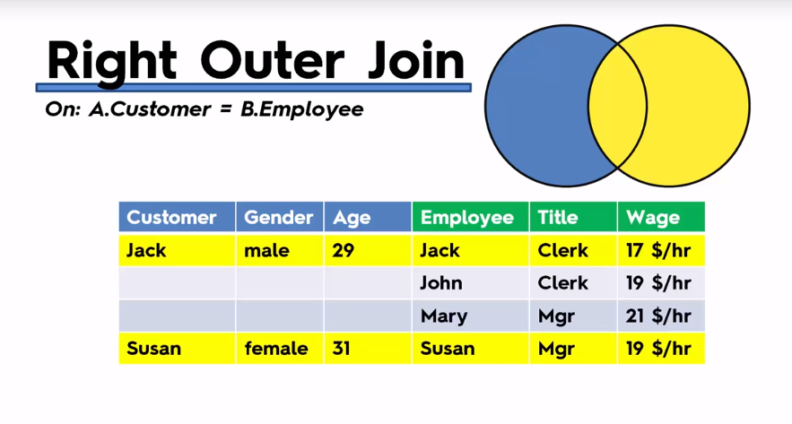
Right Join Result

Slide 14
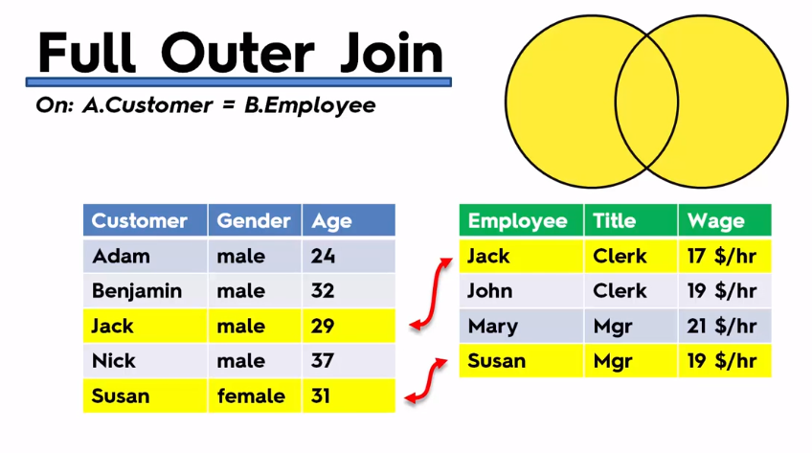
Full Outer Join

Slide 15
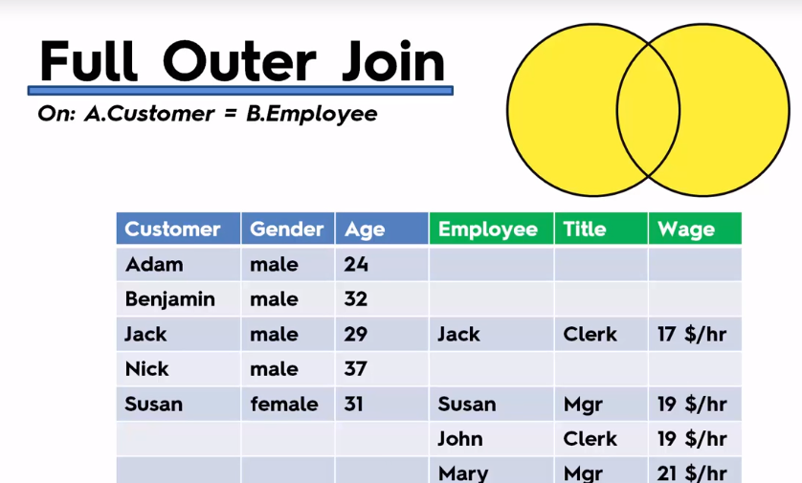
Full Outer Join Result

Slide 16
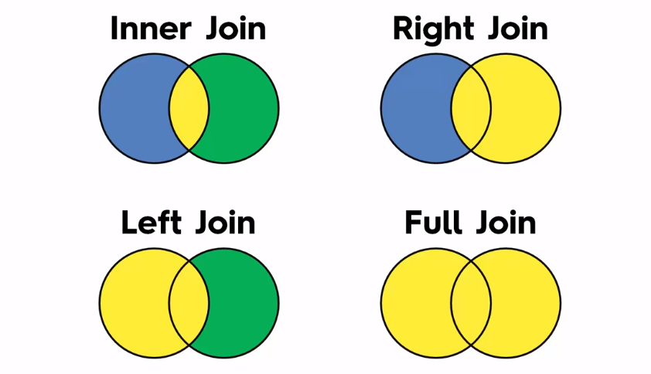
Joins

Slide 17
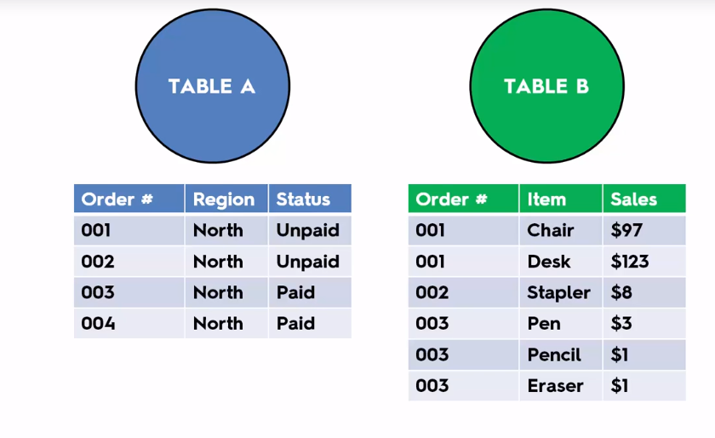
Duplicates in Joins

Slide 18
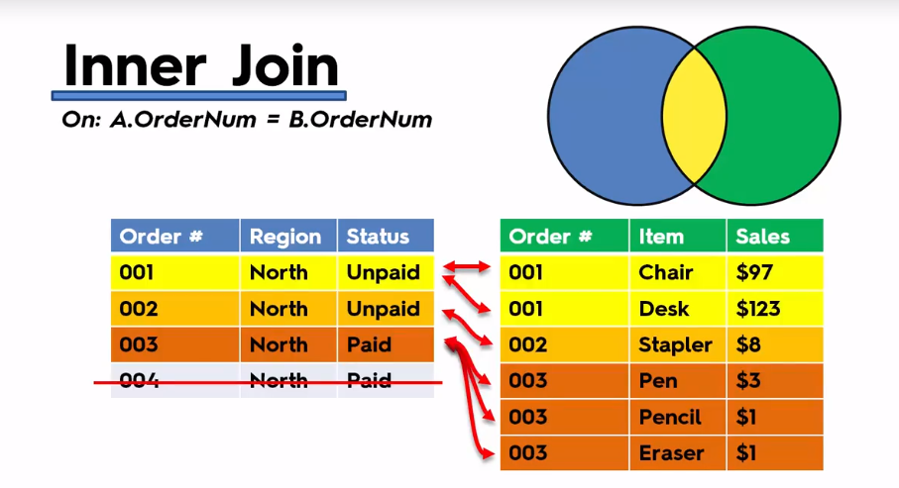
Matches

Slide 19
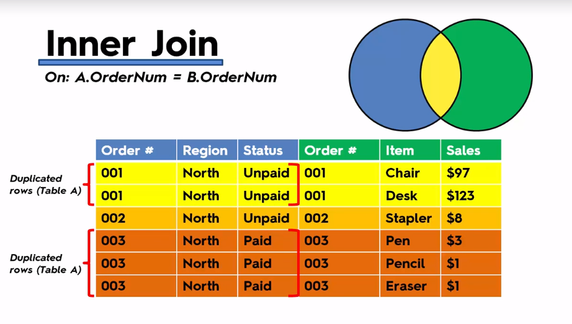
Result

Slide 20
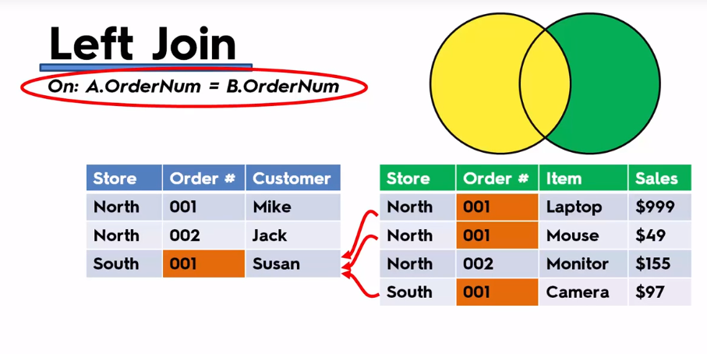
Joining Multiple Fields

Slide 21
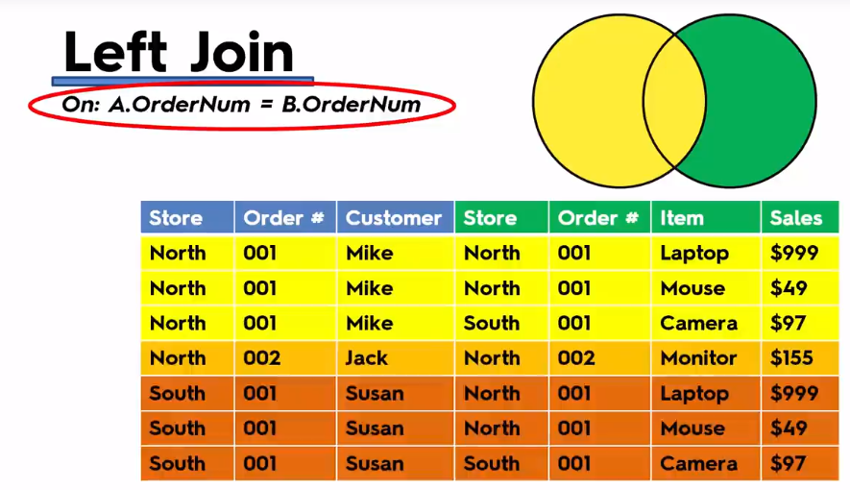
Incorrected Result

Slide 22
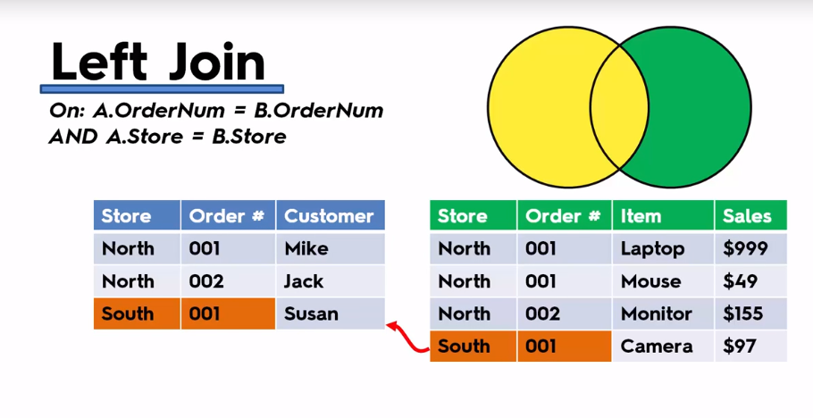
Correct Selection of Field

Slide 23
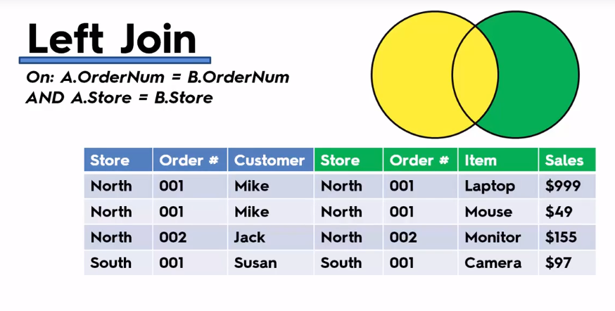
Result

Slide 24
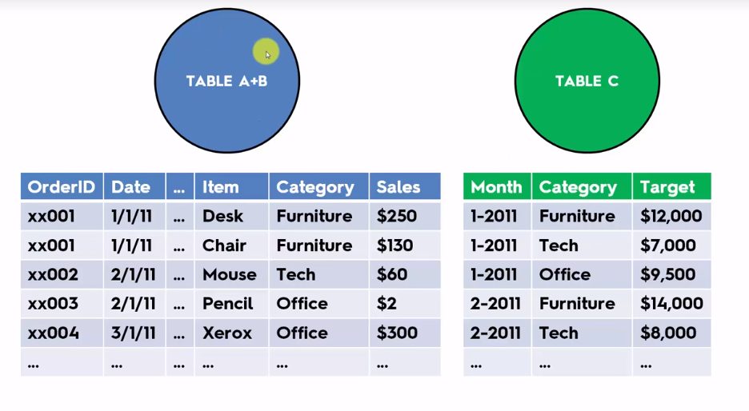
3 tables

Slide 25
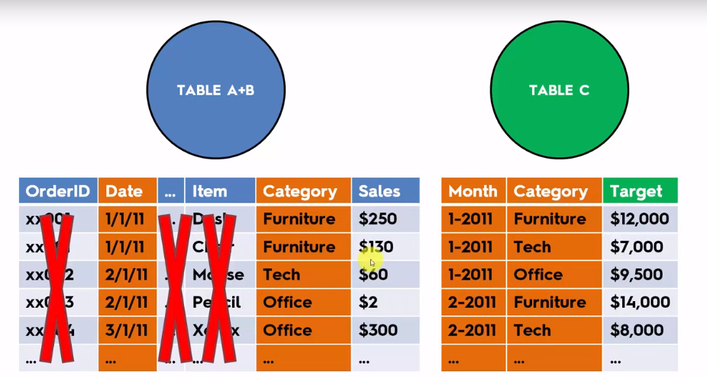
Is this was needed

